Slide 1


Session 6
Introduction to DeFi
Blockchain Protocols and Decentralized Applications

Slide 2
Blockchain
Cool technology
Who is in control?
Who own it?
Decentralized control
Use cases?

Slide 3
DeFi

Slide 4
TradFi - Payments
Classic payment: actors?
Trust actors: bank, payment processor
Issues:
Extra cost
Reliability issues (lack of availability, loss of funds)
Positive side:
Guarantee Funds
Regulations

Slide 5
TradFi - Monetary policies
Government/Banks powerful decisions
Print money - inflation
Allow Borrowing?
Establishing the lending/borrowing rate
Stop you from having a bank account
Lock your funds/assets
Payments over 5000 RON must be vetted/approved
If business considered not legit, block access to banks
Ex: medicinal purposes

Slide 6
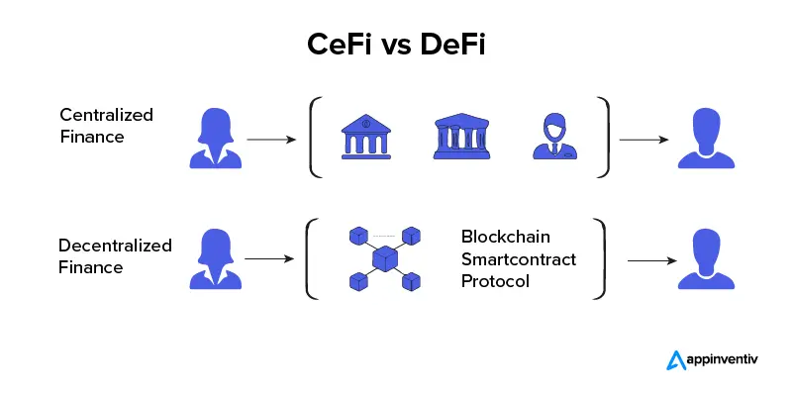
DeFi
https://appinventiv.com/blog/defi-vs-cefi/

Slide 7
DeFi
Logic in Smart Contracts
Decision Factor - Code
Open to anyone
No “blind trust” needed - just read the code
DeFi Cost -> Blockchain Cost
Custody: ownership
Components:
Cryptography
Blockchain
Smart Contracts

Slide 8
DeFi
Permissionless
No necessary approval/acceptance
Increased Accessibility
Trustless
Transparent decision making - code is king
Public Verification: Transparent for ALL transactions
Immutability
Code is law

Slide 9
DeFi
Stablecoins
DAI, TETHER, USDC - 1$
Mint/Burn
Lending and Borrowing
Collateral: TradFi vs DeFi
Legal bound of payback: TradFi vs DeFi
Trust actor: TradFi vs DeFi
Decentralized Exchanges (DEX)
High Fees on exchanges
Automated Market Makers
Insurance
Decision making is written in code
Farming example

Slide 10
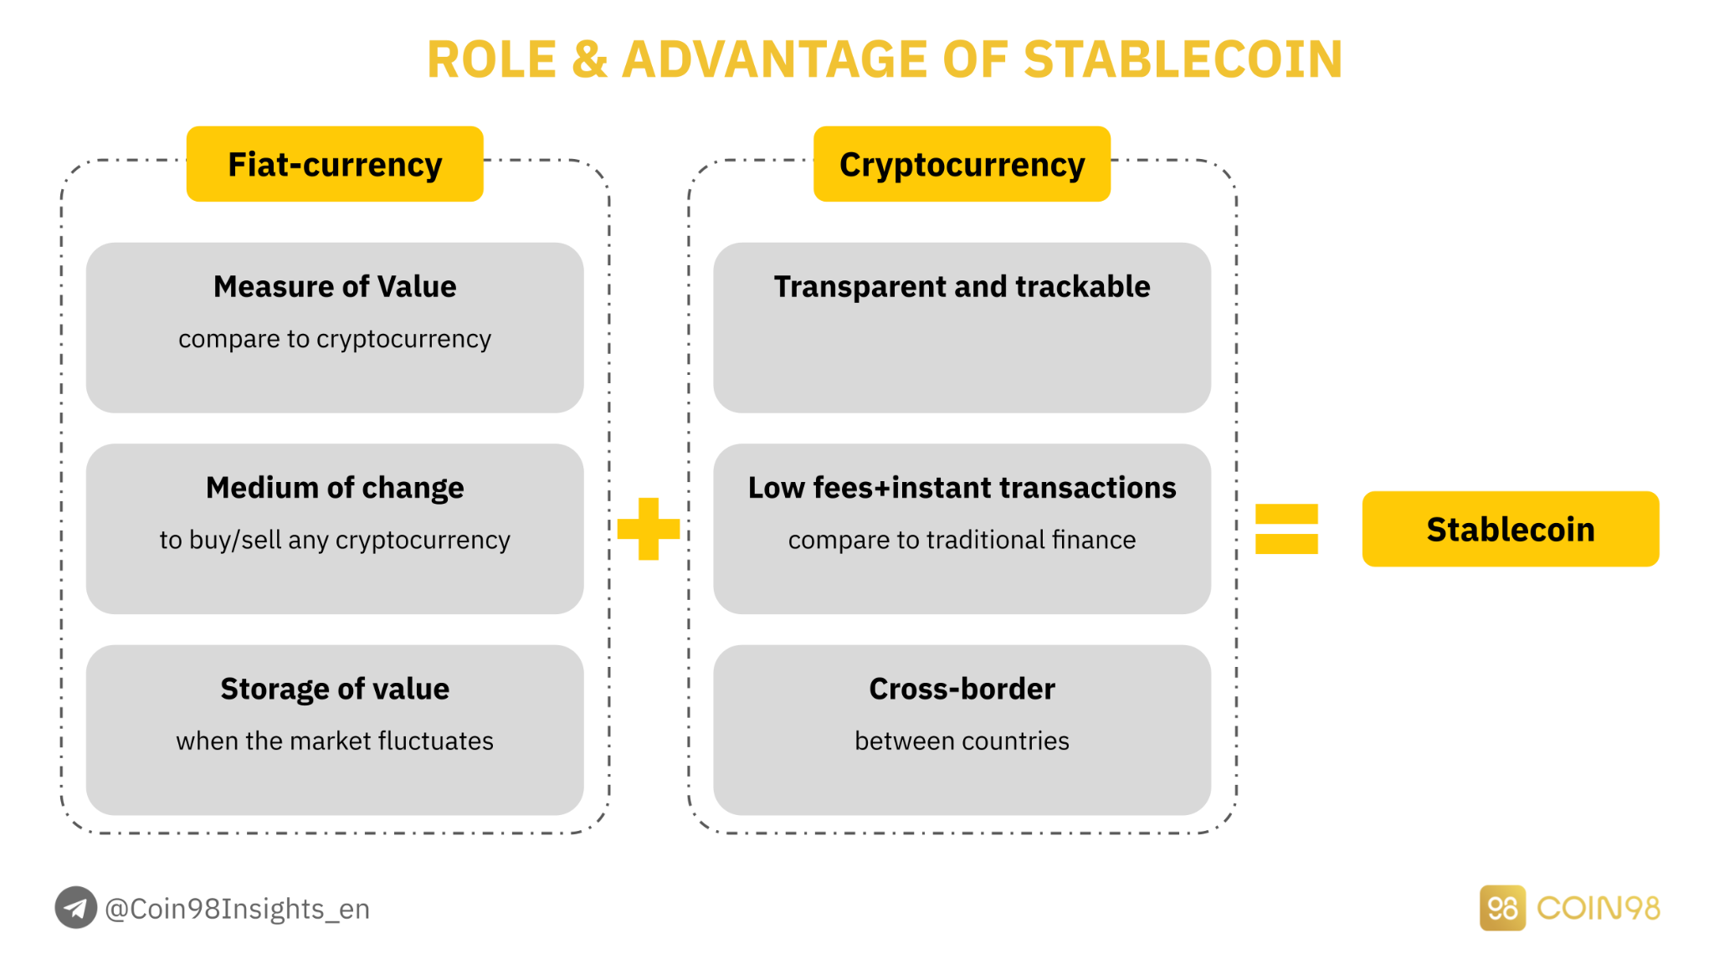
Stablecoins
https://coin98.net/stablecoin-analysis

Slide 11
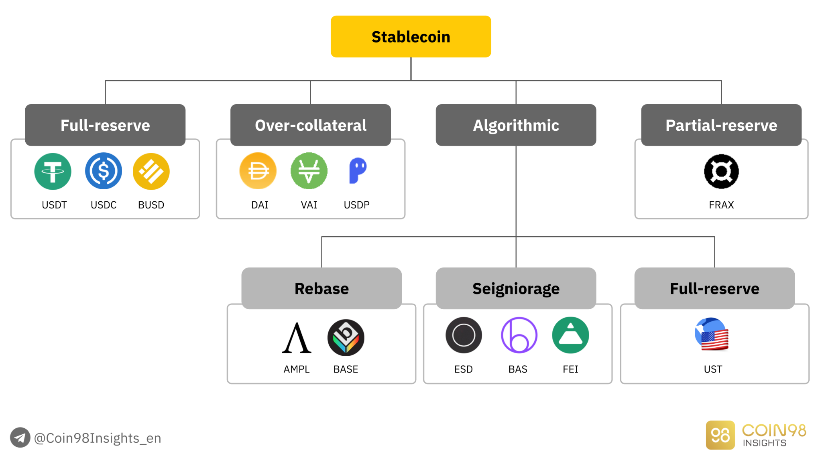
Stablecoins
https://coin98.net/stablecoin-analysis

Slide 12
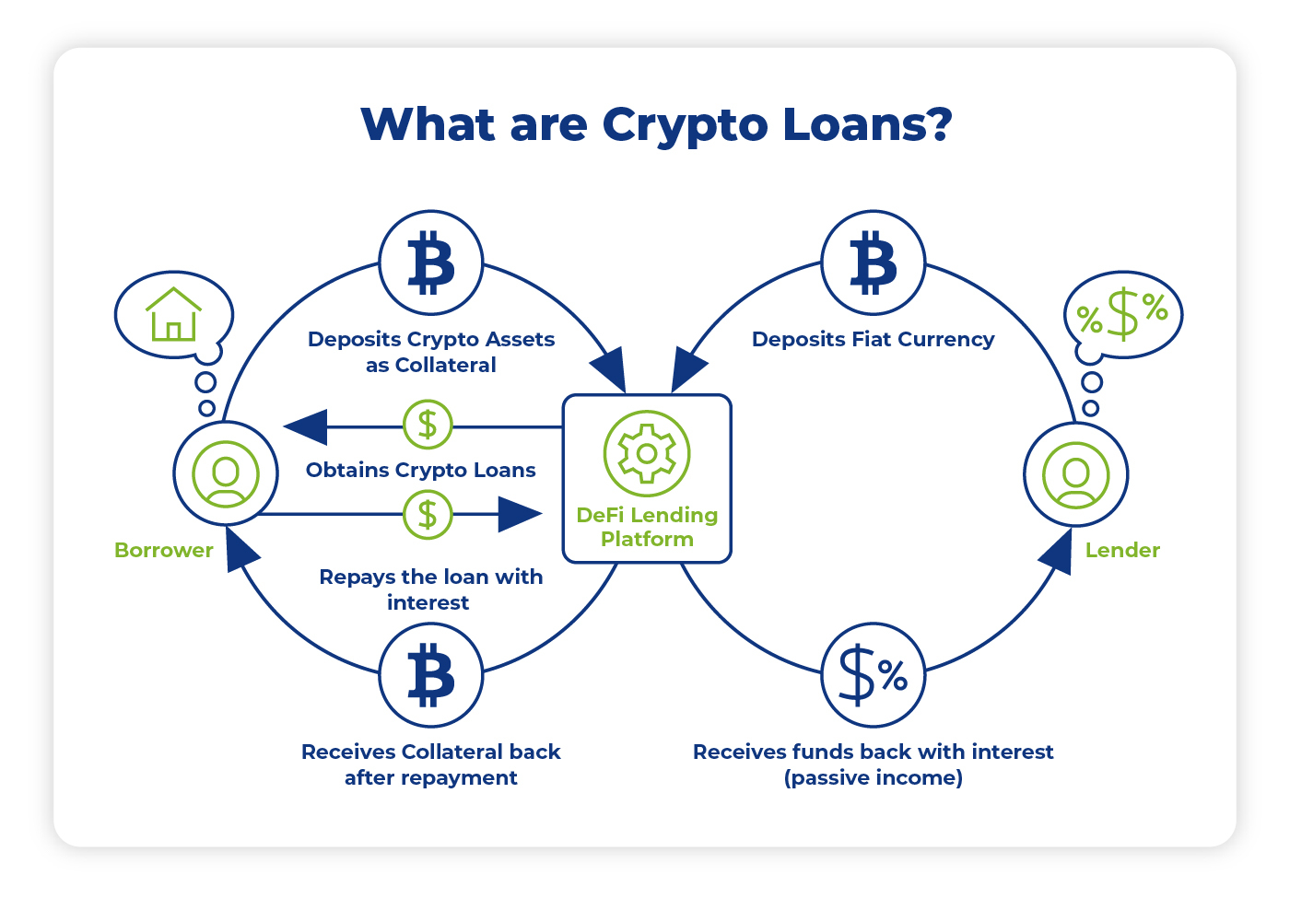
Lending and Borrowing
https://www.yield.app/blog/defi-lending-and-borrowing-guide

Slide 13
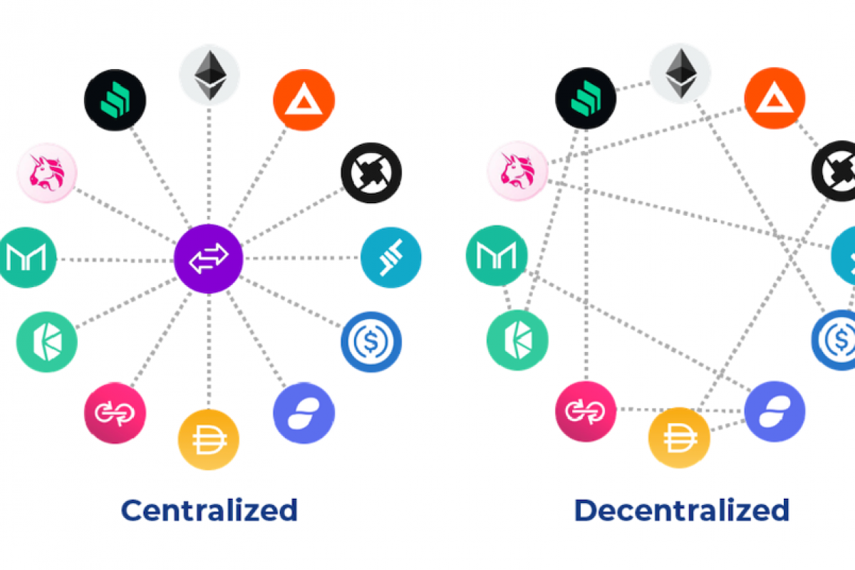
CEX vs DEX
https://medium.com/veniceswap/dex-why-the-decentralized-exchange-is-so-interesting-7b716cd0a5b5

Slide 14
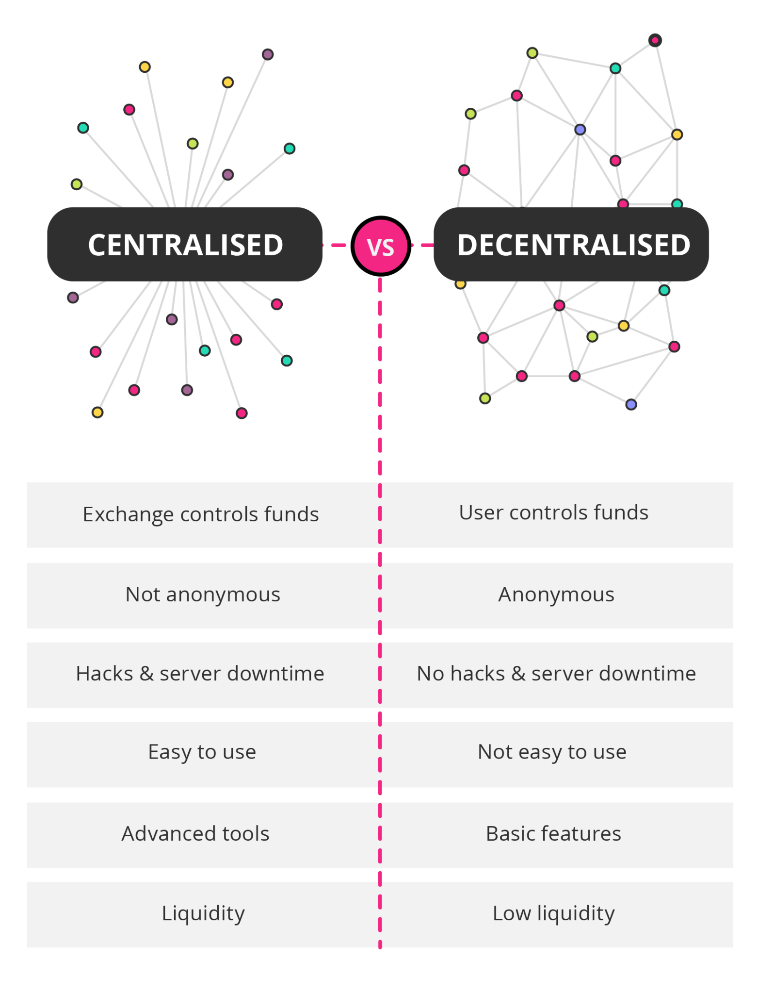
CEX vs DEX
https://www.getsmarter.com/blog/market-trends/how-decentralised-exchanges-will-affect-the-cryptocurrency-market/

Slide 15
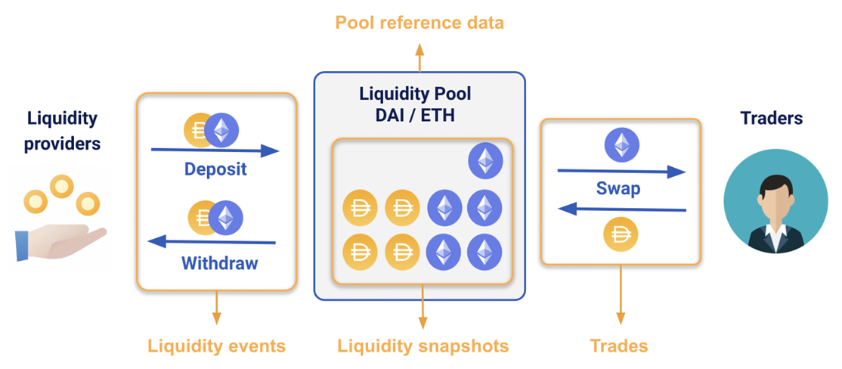
DEX - Liquidity Providers
https://blog.kaiko.com/dexs-diving-into-the-data-5addddd9dd7b

Slide 16
DEX
Actors:
Liquidity Providers
Users wanting to swap
Swap = Transaction on Blockchain
Fees:
Fee for transaction (goes to validators)
Fee for swapping (goes to liquidity providers)

Slide 17
DEX
Demo:
Swap
Create our token
Put a price on our token
Lending & Borrowing

Slide 18
CEX
Exchange platforms
Know Your Customer (KYC)
Anti Money Laundering (AML)
Customer support

Slide 19
Automated Market Makers
Sell token A, buy token B
Exchange RON to EUR -> sell RON, buy EUR
CEX exchange rate
Central entity (BNR, Dristor Exchange)
Demand and Offer (stock prices)
User finds price acceptable -> performs transaction
DEX - exchange rate
Algorithm

Slide 20
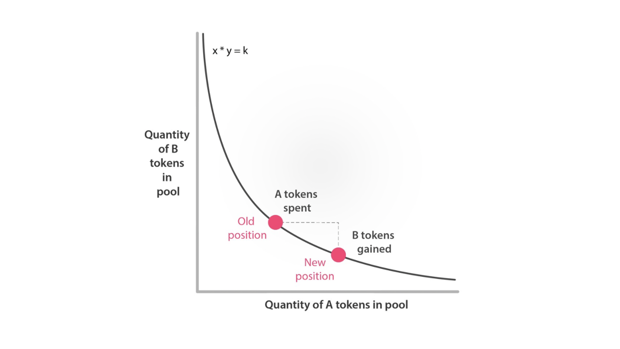
Automated Market Makers

